Slide 1



BAPUJI EDUCATIONAL ASSOCIATION®
BAPUJI INSTITUTE OF ENGINEERING AND TECHNOLOGY
DAVANGERE-577004
DEPARTMENT OF ELECTRONICS & COMMUNICATION ENGINEERING
Project Work Presentation
Design and Analysis of Controller Area Network Protocol
Project Associates
4BD22EC007
4BD22EC025
4BD22EC057
4BD22EC069
Amith A V Chirag S Mayuri S M Rahul Pattar
Smt. Radhika Priya
M.Tech,MISTE.,MIETE
Project Guide
Dr. G S Sunitha
M.Tech. (DEAC), Ph.D., MISTE, FIETE., FIE
Program Coordinator

Slide 2

VISION OF THE DEPARTMENT
To be in the forefront in providing quality technical education and research in Electronics & Communication Engineering to produce skilled professionals to cater to the challenges of the society.
MISSION OF THE DEPARTMENT
M1. To facilitate the students with profound technical knowledge through effective teaching learning process for a successful career.
M2. To impart quality education to strengthen students to meet the industry standards and face confidently the
challenges in the program.
M3. To develop the essence of innovation and research among students and faculty by providing infrastructure and conducive environment.
M4. To inculcate the student community with ethical values, communication skills
leadership qualities, entrepreneurial skills and lifelong learning to meet the societal needs.

Slide 3
Project Work (Phase 2):
Course Learning Objectives:
This course will enable students to:
Prepare with foundation knowledge in a project domain through designing, and implementing.
Introduce to various emerging fields in electronics and communication.
Provide an opportunity to exercise the creative and innovative qualities, to become Technopreneurs in group project environment.
Have hands-on experience in the related field so that students can integrate and reinforce what has been taught in the classroom.

Slide 4
INTRODUCTION
The Controller Area Network (CAN), developed by Bosch in 1986, enables reliable and efficient communication between multiple microcontrollers in vehicles, robotics, and industrial systems.
Need for CAN Transceivers:
A CAN transceiver interfaces the controller with the bus, converting digital signals into differential form while providing noise, short-circuit, and voltage protection.
CMOS-Based Design:
This transceiver is designed using a 0.5 µm n-well CMOS process, offering low power, low cost,
and high integration compared to bipolar or BiCMOS technologies.
Main Features:
It includes transmitter and receiver circuits with slew rate control, thermal and voltage protection.

Slide 5
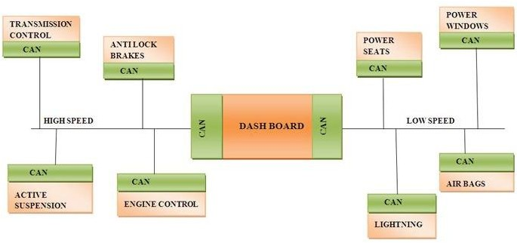
Block Diagram of Controller Area Network
12 / 4 / 2025
5

Slide 6
LITERATURE SURVEY
Attribute | Paper 1 | Paper 2
Title | Design of the Circuits for a CMOS CAN Transceiver Chip with Slew Rate Control | Implementation of CAN Bus Protocol
Authors / Year | Huihui Zhan et al. (2012) | Shinde et al. (2014)
Publication / Source | Advanced Materials Research | IJRITCC(International Journal on Recent and Innovation Trends in Computing and Communication)
Objectives / Issues Addressed | Full-custom CMOS CAN transceiver; Slew rate & protection features | Low-cost CAN integration via SPI and microcontrollers
Parameters Evaluated | Slew rate, delay, drive strength, temperature tolerance | Latency, node communication integrity
Adaptive Technique Used | Slew rate control via Rs and current mirrors | SPI via MCP2515, modular ECU- based topology
Drawbacks | Focused on analog layer only, no digital controller integration | Not scalable to ASIC or SoC, MCU- only focus
Open Issues / Improvements | Combine with digital CAN core, enable SoC design | Add EMI, fault tolerance; port to hardware

Slide 7
Attribute | Paper 3 | Paper 4 | Paper 5
Title | Design and Verification of a CAN Controller for Custom ASIC | Design Method of CAN Bus Network for Electric Vehicle | An FPGA Implementation of CAN Protocol in Automobiles
Authors / Year | Namsub Kim et al. (2005) | Li Ran et al. (2010) | Pardeep Kaur, Chanpreet Toor (2017)
Publication / Source | ICC CAN in Automation | IFOST IEEE Conf. | AJBAS(Australian Journal of Basic and Applied Sciences)
Objectives / Issues Addressed | ASIC-optimized CAN IP, ISO conformance, low gate count | SAE J1939-compliant EV CAN network topology and protocol | FPGA-based dynamic scheduling of CAN messages
Parameters Evaluated | Gate count, error detection, conformance testing | Node mapping, frame integrity, transmission stability | Response time, bit count, deadline alignment
Adaptive Technique Used | Modular verification + FIFO buffer architecture | SAE J1939 extension, ID mapping table | Dynamic ID window for arbitration and scheduling
Drawbacks | Limited flexibility in legacy CAN mode; complex verification | No circuit-level simulation or noise analysis | Doesn’t include physical layer modeling
Open Issues / Improvements | Extend to CAN FD, modular IP reuse via AI-driven arbitration | Add PHY-layer simulation for EMI/noise robustness | Combine with analog driver/transceiver for full-stack implementation ₇
12 / 4 / 2025

Slide 8
PROBLEM IDENTIFICATION
Excessive Wiring in Traditional Systems
Point-to-point communication caused bulky and complex wiring
Resulted in increased vehicle weight
and higher costs
Inefficient Communication Methods
No standardized method for reliable multi-device communication Existing methods lacked speed and robustness
Poor Fault Tolerance
Legacy protocols offered limited error detection
Not suitable for noisy or critical
environments
4. Scalability Limitations
Difficult to integrate new devices into
existing networks Required major hardware modifications
5. Lack of Real-Time Support Time-critical systems (e.g., engine control) need deterministic data transmission
Older protocols failed to meet real-
time performance needs

Slide 9
Objective :
Design a transmitter and receiver circuit for the CAN protocol at the transistor level using CMOS technology.
To provide strong protection mechanisms, including over-voltage, under-voltage, short-circuit, and thermal shutdown protection, ensuring reliability in harsh environments.
To develop a synthesizable RTL design in the Cadence environment that generates accurate CAN_H and CAN_L differential waveforms, enabling verification of the CAN physical-layer behaviour at the digital level.

Slide 10
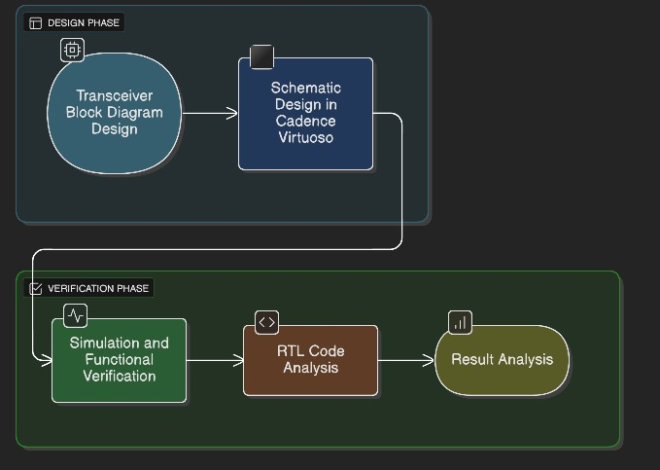
Methodology:

Slide 11


Tools Utilized:
Cadence Tool:
Cadence is a suite of electronic design automation (EDA) tools used for designing, simulating, and verifying integrated circuits (ICs), including digital, analog, and mixed-signal systems.
Key Features :
Schematic Design
Simulation
Layout Design
Verification
Synthesis & Timing Analysis

Slide 12
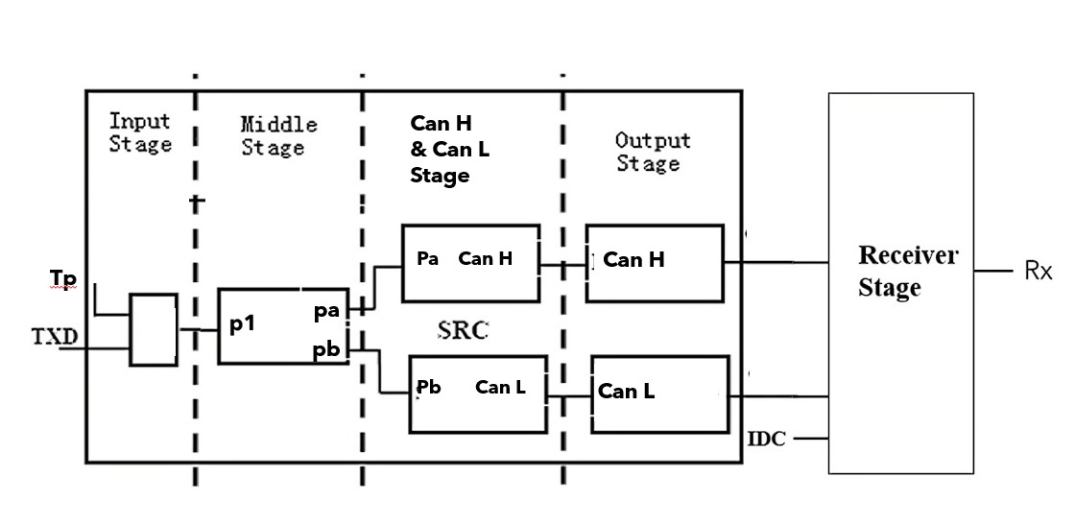
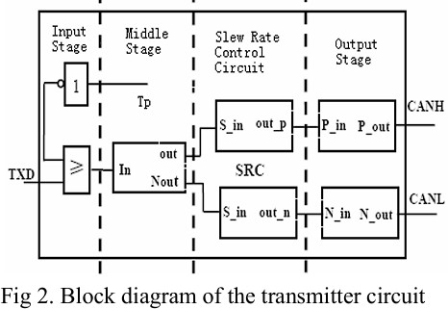
Block Diagram of Transreceiver circuit
Receiver Stage
CAN_H &
Tp
CAN_L Stage
Rx
IDC
TXD and Tp enter the chip; outputs are CANH/CANL.
Signal passes through Input → Middle → SRC → Output.
Differential signaling provides noise immunity on CAN bus.
12
12 / 4 / 2025

Slide 13
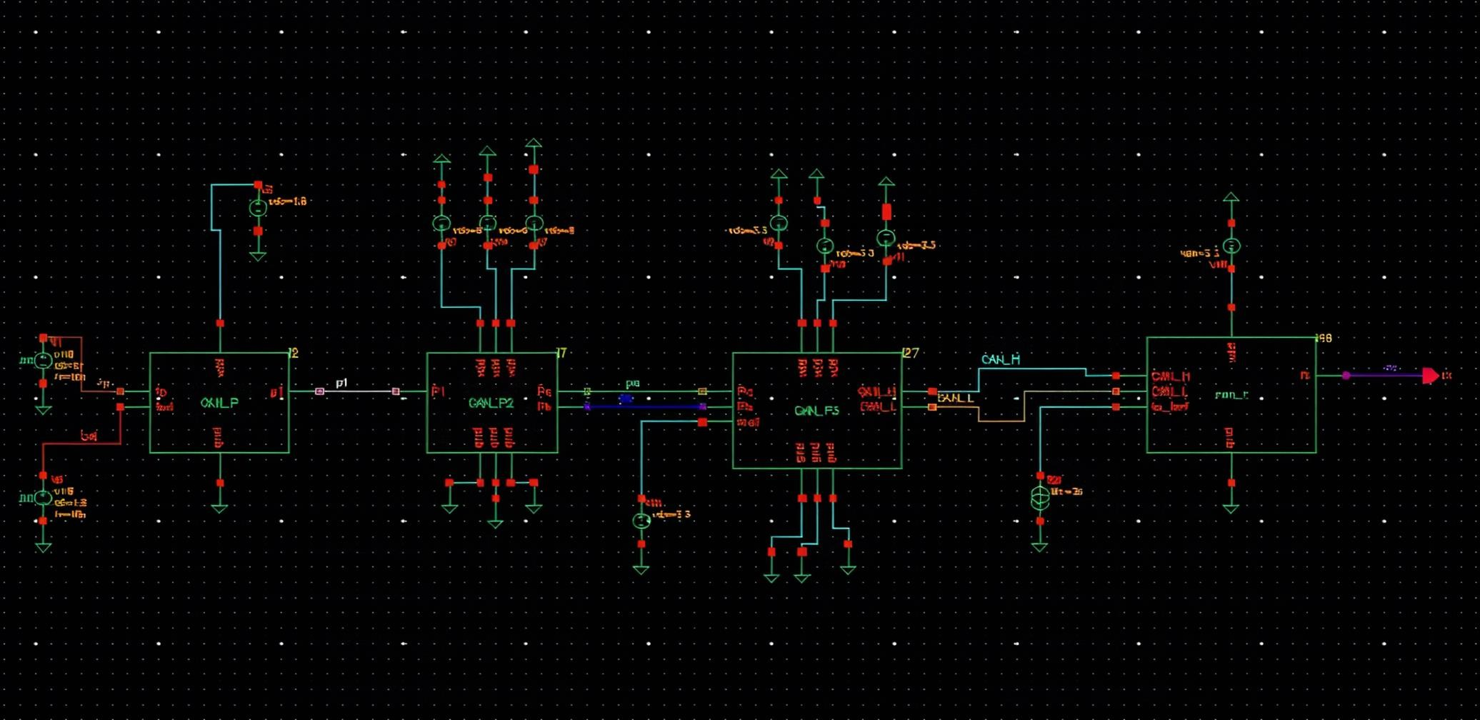
CMOS-Based CAN Transceiver (Transmitter, Receiver, and Protection Circuit)
12 / 4 / 2025
13

Slide 14
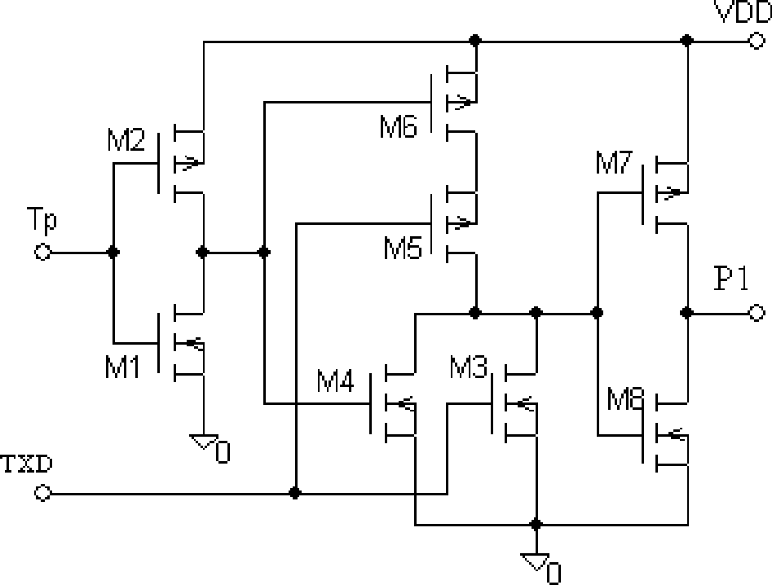
Input stage
Accepts data to transmit (TXD) and a shutdown
signal (Tp) for thermal protection.
If the chip gets too hot (>150°C), transmitter locks high, saving it from damage and power drain.
TXD | Tp | NOT Tp | Output= (Not(Txd+Not Tp))
0 | 1 | 0 | 1
1 | 1 | 0 | 0
0 | 0 | 1 | 0
1 | 0 | 1 | 0
12 / 4 / 2025
14

Slide 15
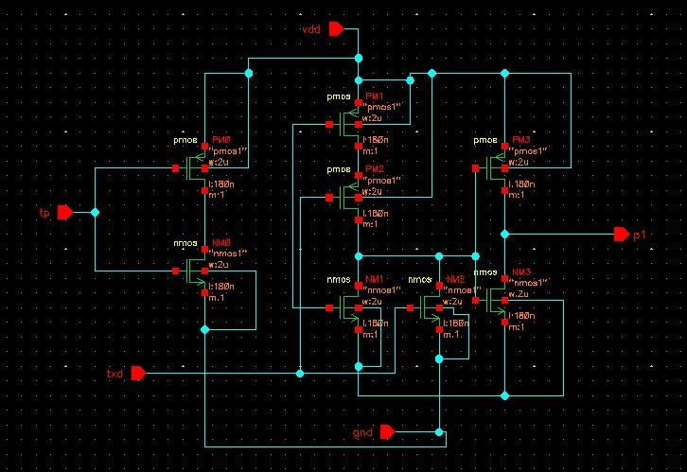
Input stage
To match CAN logic:
TXD = 0 → Output HIGH → Bus dominant (active)
TXD = 1 → Output LOW → Bus recessive (idle)
To clean the signal:
Inverter sharpens TXD edges and removes noise
before amplification.
To support thermal protection:
When chip overheats (Tp = 0), output stays HIGH
→ Bus remains recessive → safe mode.
To keep correct phase:
Makes sure later stages (Pa/Pb, CANH/CANL) switch correctly with CAN standard.
Schematic in Cadence Virtuoso

Slide 16
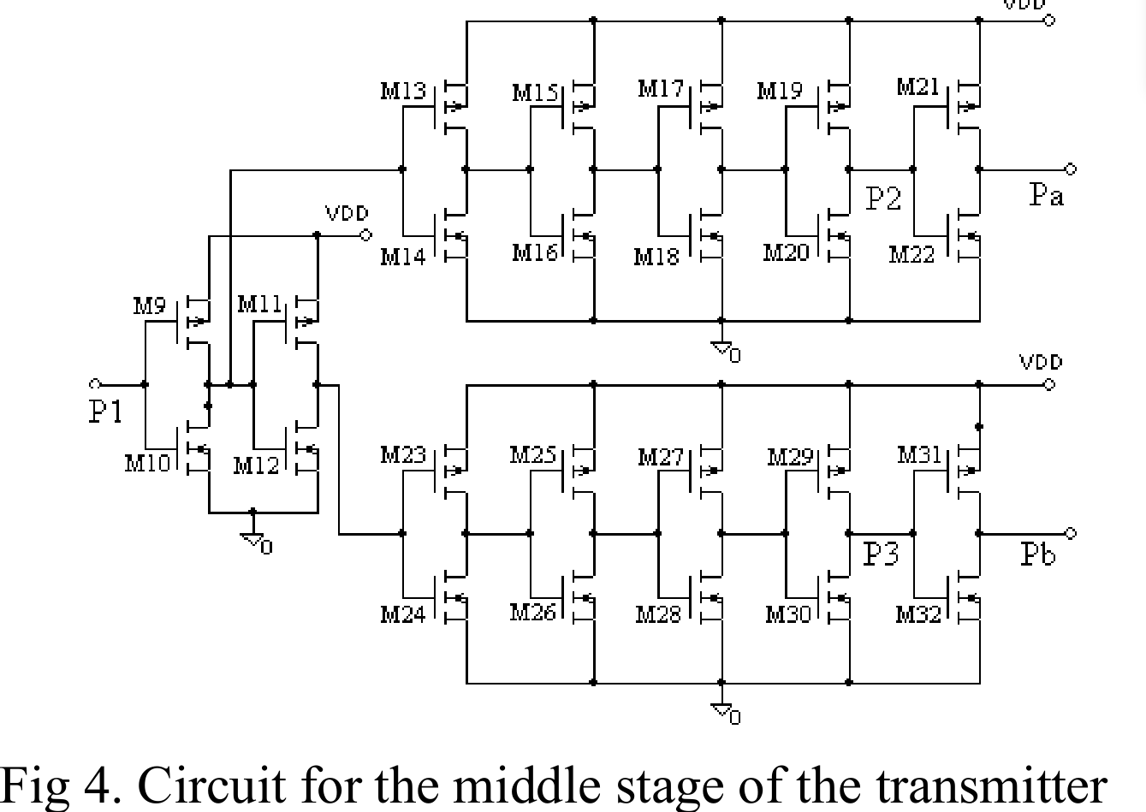
Middle stage
Amplifies signal drive using
five cascaded inverters.
Each inverter is 3× larger than previous to drive large capacitances.
Ensures quick and strong signal transitions.
16

Slide 17
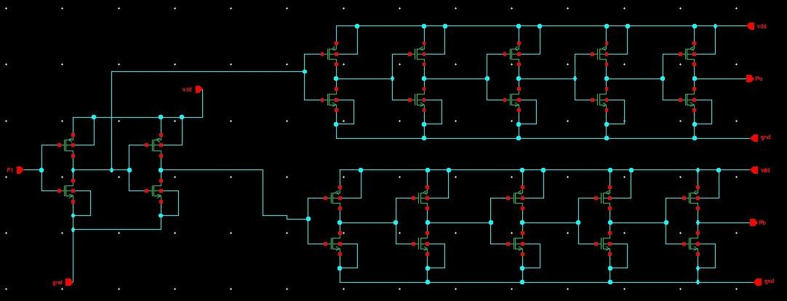
Middle stage
Differential Bus:
Instead of sending data on one wire, CAN uses two wires (CANH and CANL). The difference between them represents data.
This helps cancel noise and
improves reliability.
Schematic in Cadence Virtuoso

Slide 18
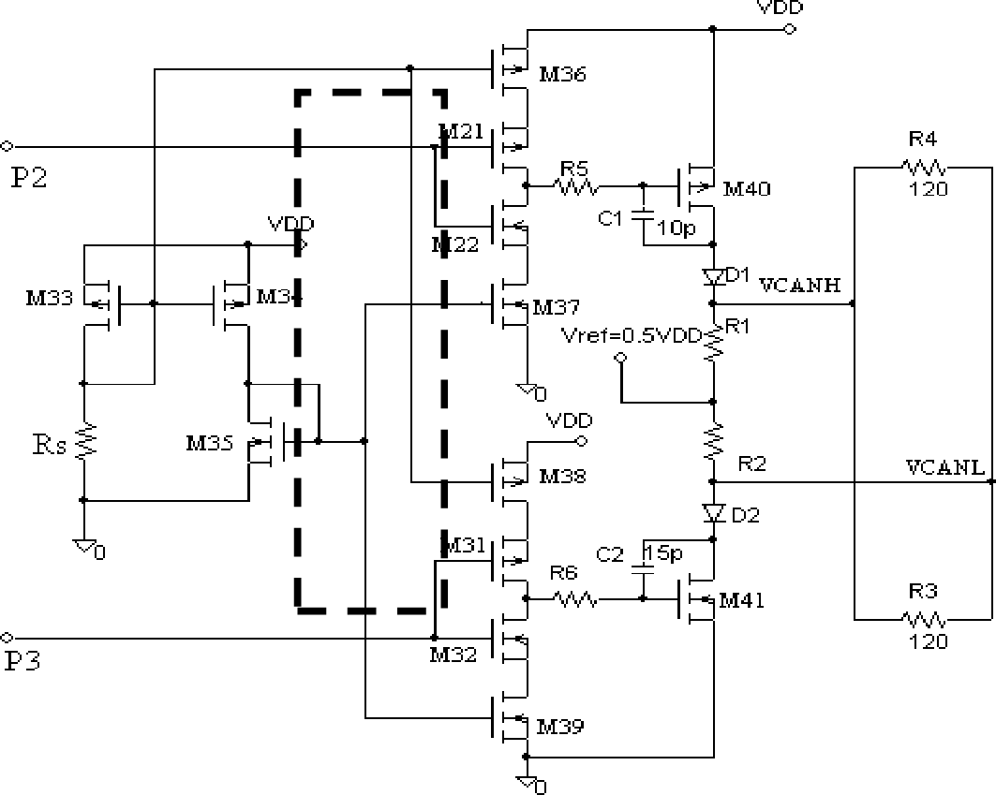
CAN_H and CAN_L Stage
Two large MOSFETs:
M40 → drives CANH (high line).
M41 → drives CANL (low line).
R1 & R2: series resistors limit short- circuit current.
D1 & D2: Schottky diodes protect against overvoltage and undervoltage.
12 / 4 / 2025
18

Slide 19
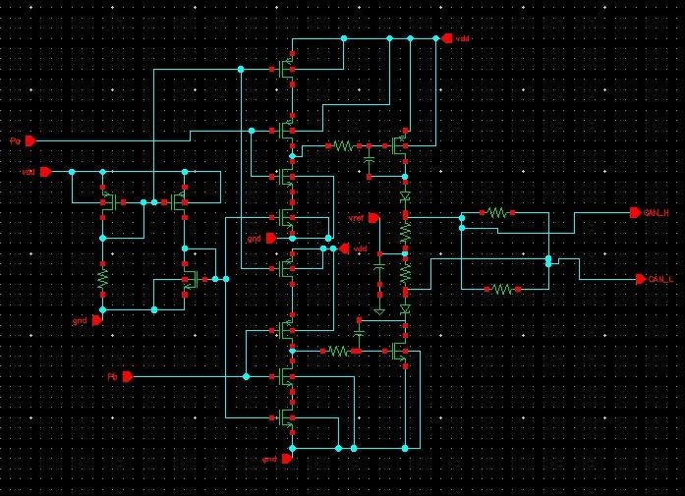
CAN_H and CAN_L Stage
Schematic in Cadence Virtuoso

Slide 20
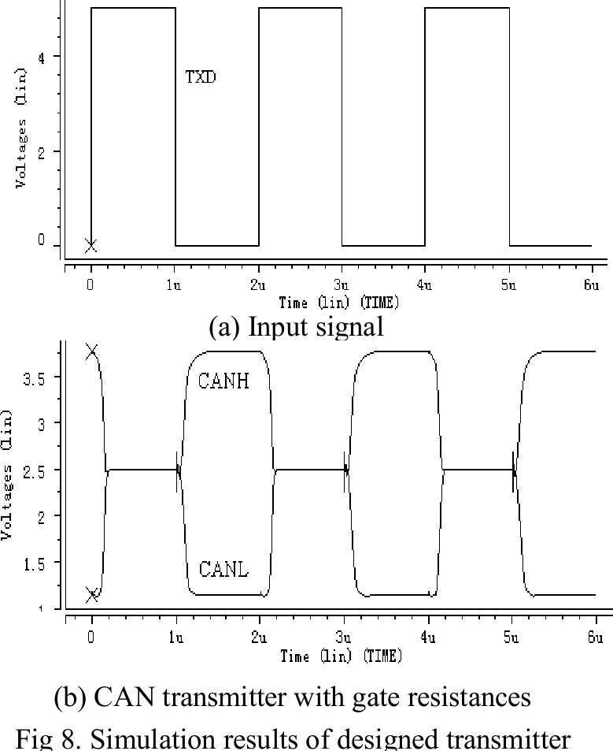
Expected Waveform
State | CAN_H Voltage | CAN_L Voltage | Difference | Bit
Dominant | 3.5 V | 1.5 V | 2 V | 0
Recessive | 2.5 V | 2.5 V | 0 V | 1
Dominant bit (0): | CAN_H > CAN_L
Recessive bit (1): | CAN_H = CAN_L
12 / 4 / 2025
20

Slide 21
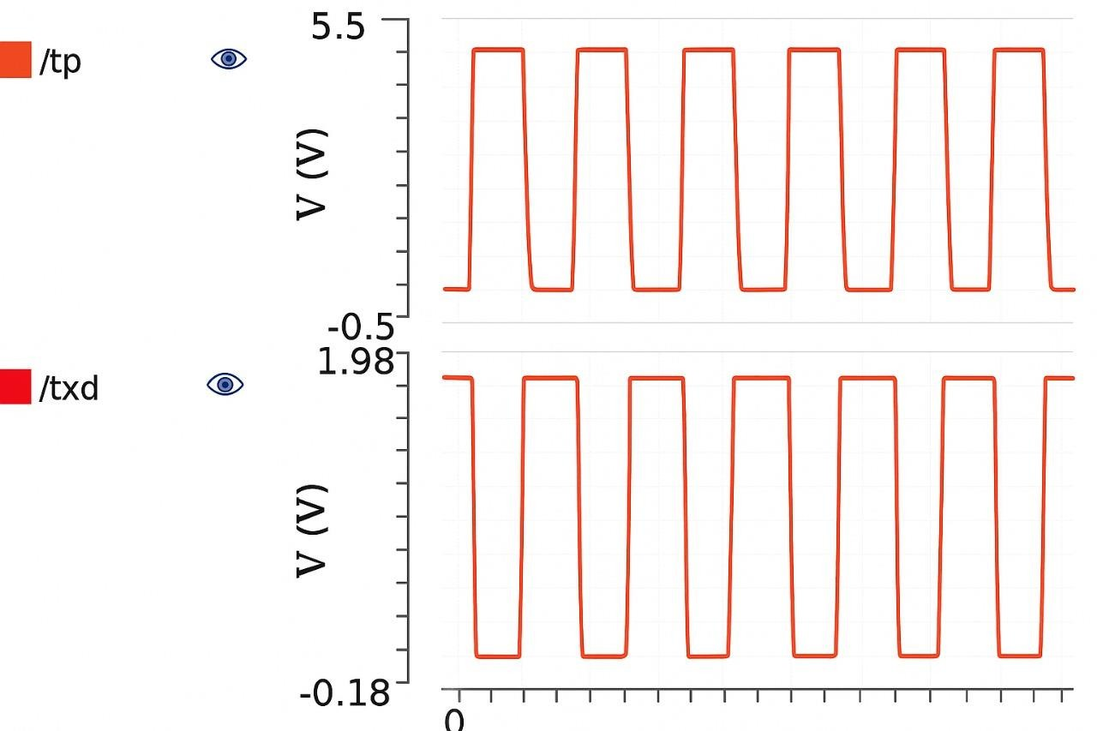
Result:
(Signal from Thermal Protection Circuit)
(Data to be Transmitted)

Slide 22
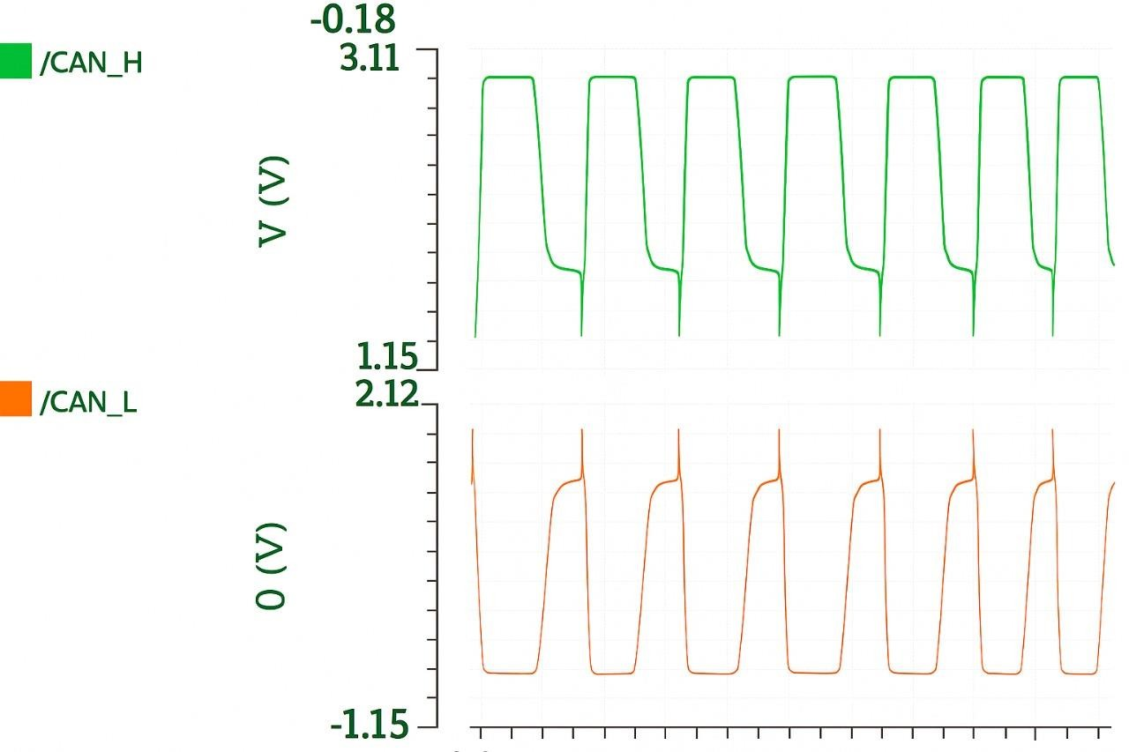
Result
12 / 4 / 2025
22

Slide 23
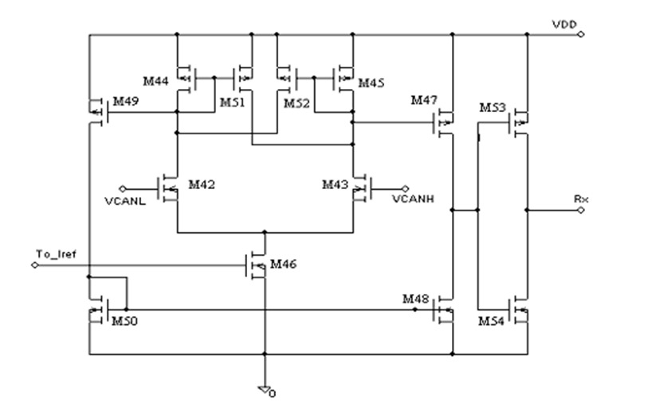
Receiver Circuit

Slide 24
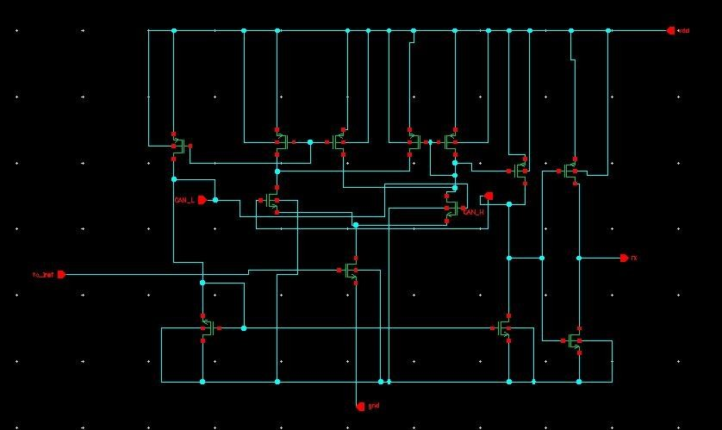
Receiver Circuit
The receiver stage of the CAN transceiver is built around a two-stage hysteresis comparator, which is essential for handling the noisy environment of a CAN bus.
The differential input signals from the bus, VCANH and VCANL, are fed into the first differential pair (transistors M42 and M43). The voltage difference between these signals represents the bus state (dominant or recessive).
12 / 4 / 2025
23

Slide 25
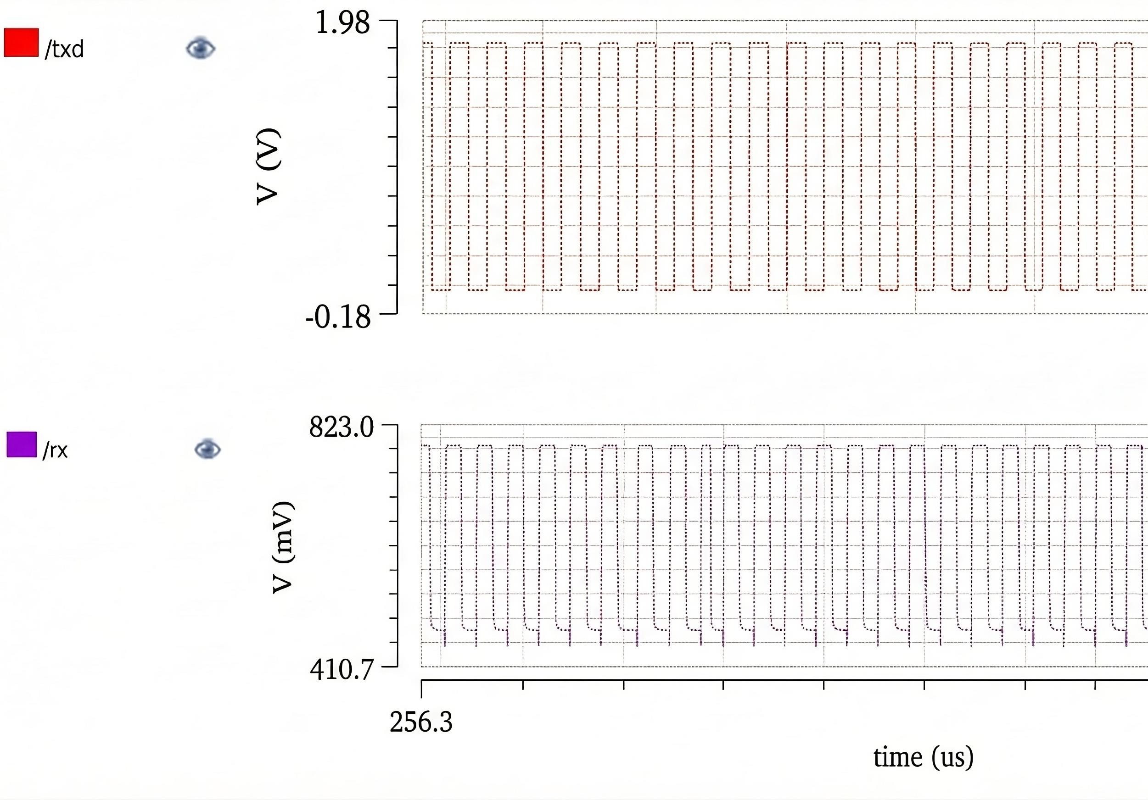
Receiving Wave Form
12 / 4 / 2025
24

Slide 26
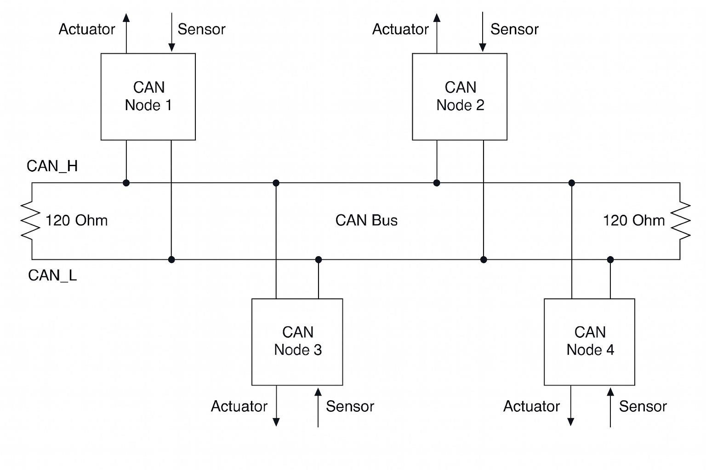
CAN Protocol Structure

Slide 27
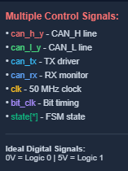
RTL Implementation Overview
Key RTL Modules:
can_top (Main Controller)
Register interface (read/write)
50 MHz clock support
Interrupt signals
can_bittiming (Bit Timing Generator)
Programmable BRP (Baud Rate Prescaler)
TSEG1, TSEG2, SJW timing
Sample point generation
can_tx (Transmitter Engine)
6-state FSM (IDLE → ARB → DATA → CRC → ACK → END)
Bit stuffing
Frame construction (SOF + ID + DLC + Data)
can_rx (Receiver Engine)
Frame detection
CRC validation
Data extraction
12 / 4 / 2025
26

Slide 28
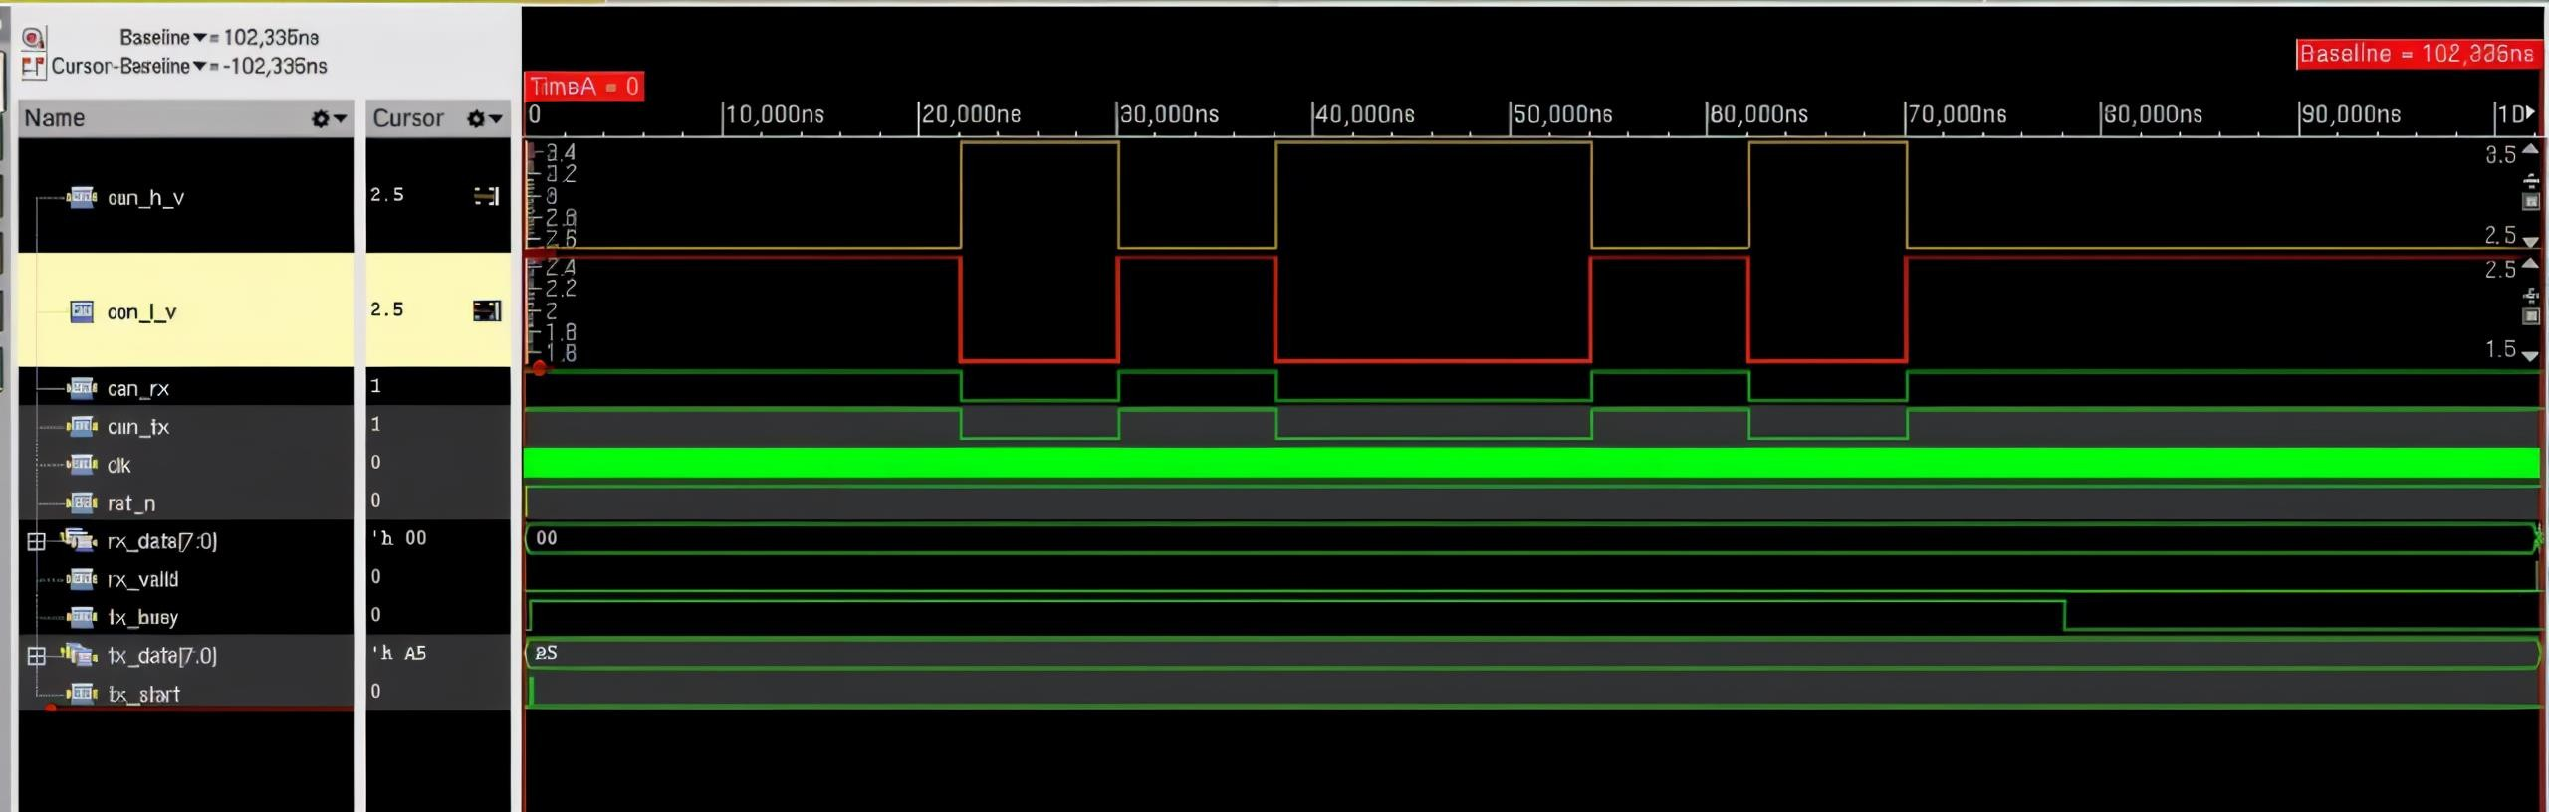
RTL Simulation
Signal Descriptions:
CAN_H_y (Yellow line): • Represents CAN_H signal
CAN_L_y (Red line): • Represents CAN_L complementary signal
For dominant 0 the CAN_H (3.5V) and CAN_L (1.5V) and for recessive 1 both are at 2.5V
12 / 4 / 2025
27

Slide 29
APPLICATIONS:
Used in automotive electronics because it supports reliable in-vehicle communication. Its strong noise immunity makes it suitable safety-critical systems.
Suitable for industrial automation where harsh electrical environments exist.
Applied in robotics systems that require dependable high-speed communication.
Useful in medical devices where compact, low-power communication interfaces are needed. The CMOS process reduces cost and power consumption, making it ideal for embedded medical systems.
Supports long-distance CAN networks as the adjustable slew rate helps reduce EMI, enabling stable signaling over extended cable lengths.
12 / 4 / 2025
28

Slide 30
ADVANTAGES:
Offers continuously adjustable slew rate using an external resistor, allowing operation in high-speed modes depending on system requirements.
Includes short-circuit, over-voltage, under-voltage, and thermal shutdown protection, improving reliability under fault conditions.
Simple two wire differential communication . It uses only CAN_H and CAN_L.
Uses low-cost CMOS technology, resulting in lower power consumption and making it economically suitable for
large-scale applications.
12 / 4 / 2025
29

Slide 31
LIMITATIONS:
Built using an older 180 nm CMOS process, which limits speed, integration, and power efficiency compared to modern technologies.
Limited to 1 Mbit/s CAN speed, making it unsuitable for newer CAN-FD applications that require significantly higher data rates.
Lacks modern low-power modes, which increases energy consumption in battery-powered systems.
Does not include advanced diagnostic features such as bus-fault detection commonly found in newer transceivers.
Thermal shutdown at 150 °C may interrupt operation in extremely hot automotive situations, affecting availability under high load.
12 / 4 / 2025
30

Slide 32
FUTURE SCOPE:
Can be improved by migrating to smaller CMOS nodes like 180 nm or 65 nm for faster speed, lower power, and higher integration.
Future versions could support CAN-FD with higher data rates (5–8 Mbit/s), expanding compatibility with modern automotive networks.
Additional diagnostic and fault-tolerant features could be integrated to improve safety, including error detection and wake-up functionality.
Adding low-power standby or sleep modes would significantly reduce energy usage in systems with long idle periods.
12 / 4 / 2025
31

Slide 33
Conclusion:
The CMOS-based CAN transceiver successfully integrates all essential blocks for reliable CAN communication.
TXD input stage operates correctly and includes thermal protection for safe operation under fault conditions.
Middle-stage driver generates accurate CANH/CANL differential signals with proper voltage levels and timing.
Simulation results confirm seamless end-to-end communication, robust differential outputs.
12 / 4 / 2025
32

Slide 34
References:
H. Zhan, S. Zong, X. Han, and C. Li, “Design of the Circuits for a CMOS CAN Transceiver Chip with Slew Rate Control,” Advanced Materials Research, vols. 433–440, pp. 1895–1902, Jan. 2012, doi: 10.4028/www.scientific.net/AMR.433-440.1895.
A. S. Shinde, A. S. Deshpande, P. N. Kalamkar, and A. R. Nichal, “Implementation of CAN Bus Protocol,” International Journal on Recent and Innovation Trends in Computing and Communication (IJRITCC), vol. 2, no. 6, pp. 1568–1573, Jun. 2014.
N. Kim, D. Kim, K. Cho, J. Kim, and W. Cho, “Design and verification of a CAN controller for custom ASIC,” in Proceedings of the 11th International CAN Conference (iCC), CiA (CAN in Automation), 2005, pp. 09-13.
D. Batas and K. Schumacher, “An integrated analog-CMOS control system for low-cost applications,” in 2002 9th International Conference on Electronics, Circuits and Systems (ICECS), Dubrovnik, Croatia, 2002, pp. 1239–1242, doi: 10.1109/ICECS.2002.1046254.
L. Ran, W. Junfeng, and W. Haiying, “Design Method of CAN BUS Network Communication Structure for Electric Vehicle,” in IFOST 2010 Proceedings, Harbin, China, 2010, pp. 1–4, IEEE.
P. Kaur and C. K. Toor, “An FPGA Implementation of CAN Protocol in Automobiles,” Australian Journal of Basic and Applied Sciences, vol. 11, no. 8 (Special), pp. 107–113, May 2017.
33
04- 12- 2025

Slide 35
Course Outcomes:
On completion of this course, students are able to:
Get exposed to literature available for research challenges in interdisciplinary fields.
Get an insight of real world problems, challenges and related engineering issues to broader societal context.
Implement their idea using modern tools & new technologies.
Demonstrate professionalism with ethics, individual & team management and
effective communication skills to comprehend & to write reports.

Slide 36
Thank YOU

